Slide 1

Multiple myeloma: What’s new?
Grace B. Athas, Ph.D. MLS
Department of pathology, LSUHSC
CLPC Spring seminar series, 2018

Slide 2

Learning objectives
Review pathophysiology and lab diagnosis of plasma cell neoplasms with a focus on Multiple Myeloma
Identify new molecular and Cytologic findings in Multiple Myeloma
Identify targeted treatments based on molecular findings in Multiple Myeloma

Slide 3
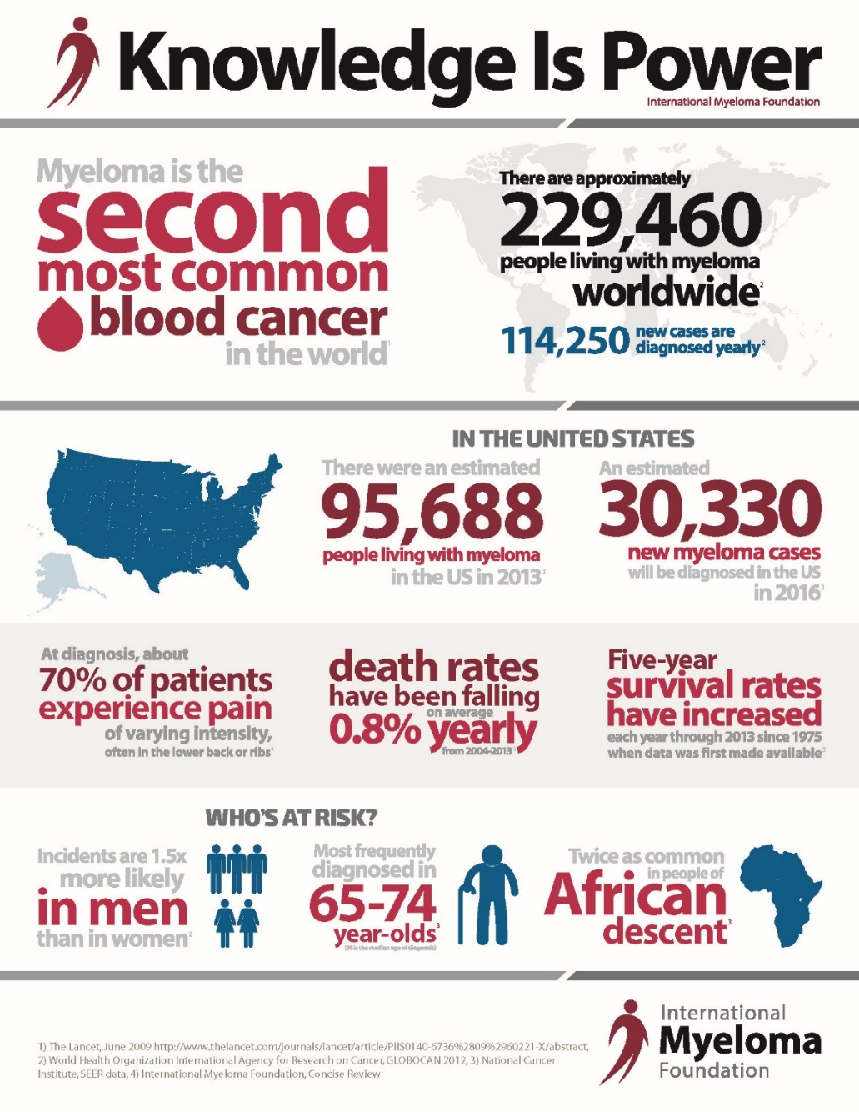
Plasma cell (multiple) myeloma
In US
  Most common lymphoid malignancy in African Americans; second in Caucasians
  African Americans 2 x more than Caucasians
Adults, usually > 50 years
  Median age 68
  Rare in adults before age 35
  NOT found in children
M/F ratio 3:2
Median survival 3-4 years

Slide 4
Etiology of MM
Genetic causes ?
Extension of MGUS
Environmental/occupational exposures
Radiation
Chronic inflammation
Infection (HH8)

Slide 5
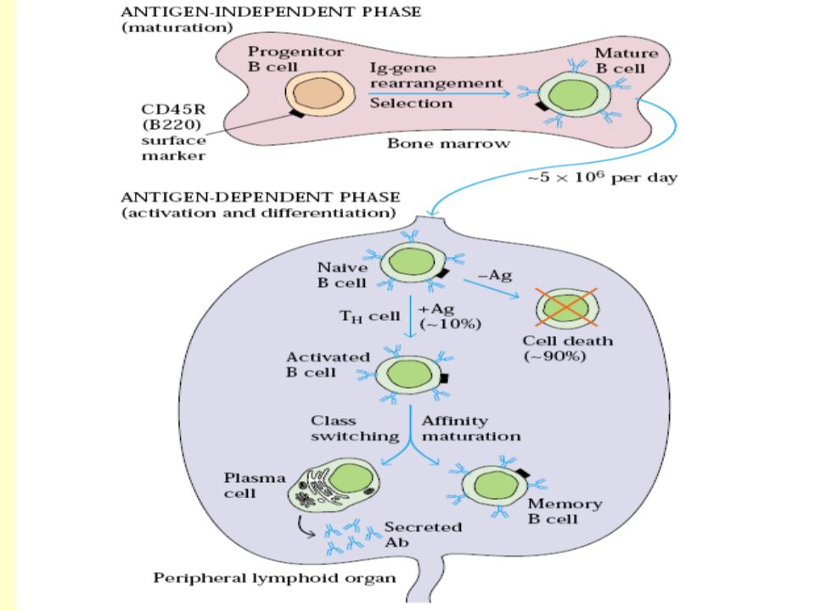
B cell maturation
Notes:
IgM and IgD on surface

Slide 6
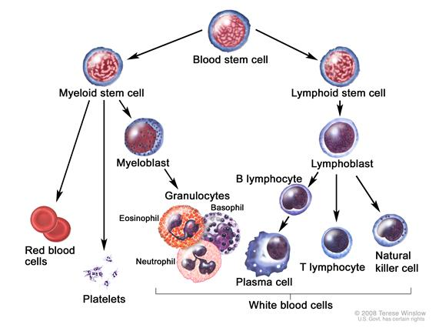
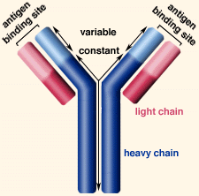
Plasma cell neoplasms
Proliferation of a single clone of Immunoglobulin-secreting plasma cells
Results in increased serum levels of a single immunoglobulin or chain

Slide 7
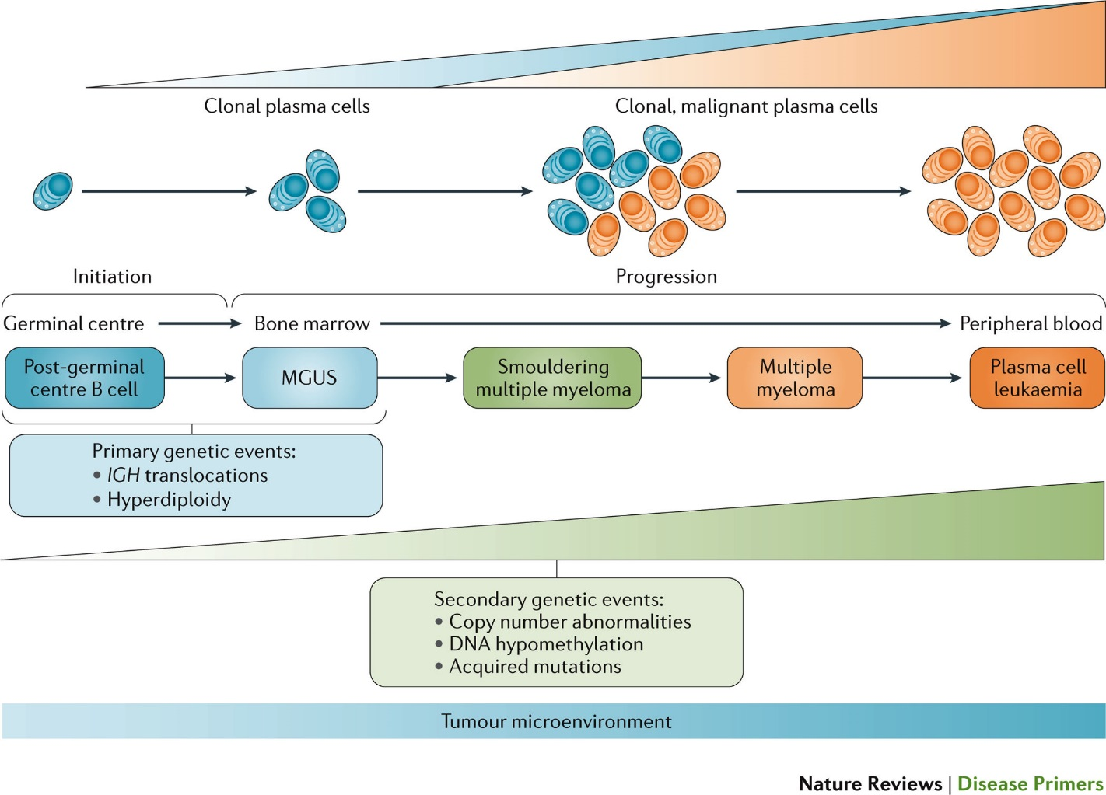
Progression of multiple myeloma

Slide 8
Plasma cell neoplasms diagnosis
Pathological
Clinical
Radiological
Molecular/Cytogenetic
Notes:
Diagnosis based on a combination of

Slide 9

LAB Evaluation for a suspected plasma cell disorder
Serum and urine protein electrophoresis
Serum and urine immunofixation and Ig quantification and light chain types
Serum free light chains
Bone marrow examination
Other labs

Slide 10
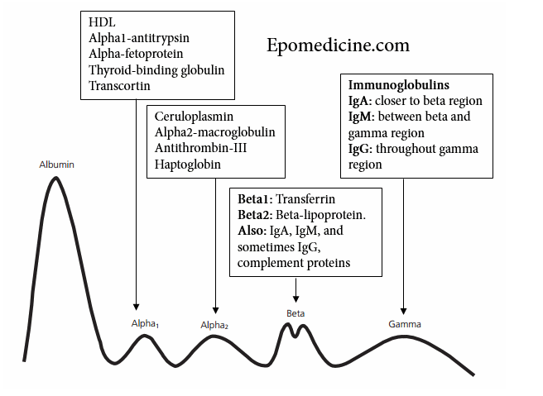
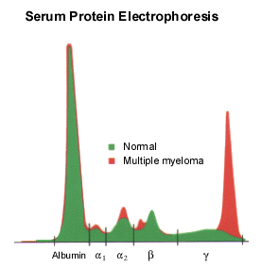
SERUM PROTEIN ELECTROPHORESIS (SPEP)

Slide 11
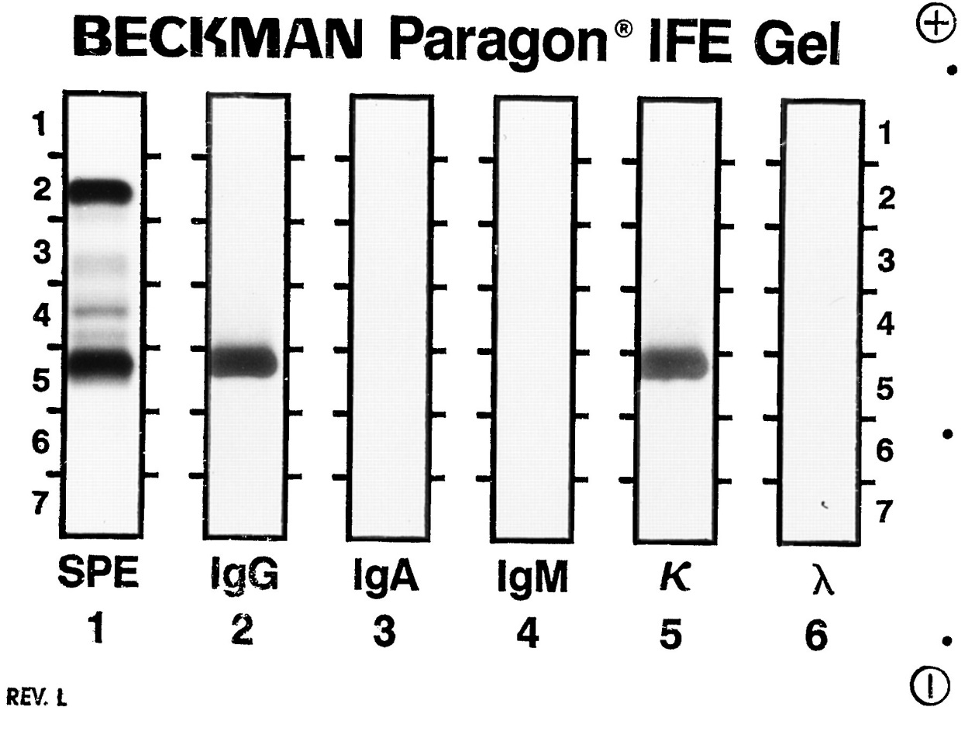
Immunofixation, IFE

Slide 12
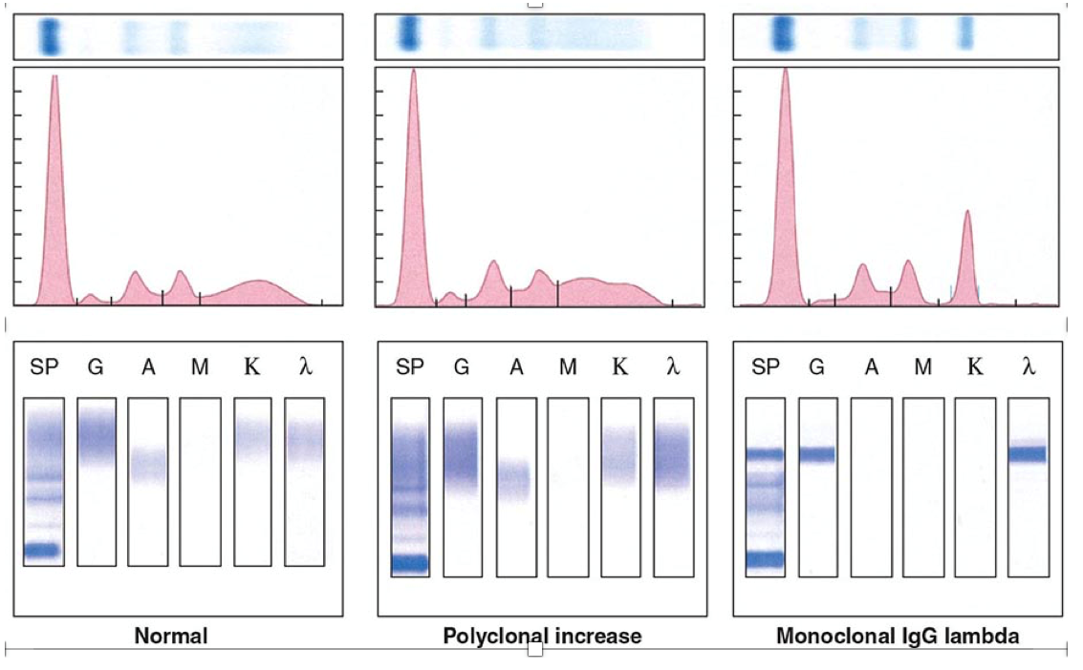
SERUM PROTEIN ELECTROPHORESIS (SPEP)
IFE: SUBTYPES THE M-SPIKE COMPONENT

Slide 13
More about monoclonal proteins in mm
75-85% have serum monoclonal IG
  IgG >>> IgA; other types rare
  Both heavy and light chain
  Paraprotein –M component- M Spike –Monoclonal Spike –on electrophoresis
10-20% make light chains only
  Rapid renal excretion
  Serum paraprotein may be absent
  Found on urine electrophoresis (UPEP)
5% Non-secretory myeloma (rare)
Other causes of monoclonal proteins
  B cell lymphomas
  Autoimmune disease
  HIV infection

Slide 14
Serum Free Light Chains
2 types of light chains, kappa or κ and lambda or λ
Each plasma cell produces only one type of heavy and light chain
Heavy and light chains are produced separately within the plasma cells and are assembled to form a whole (“intact”) immunoglobulin
Light chains attached to heavy chains: “bound light chains”
Light chains not attached to the heavy chains: “FREE LIGHT CHAINS”
Plasma cells typically produce more light chains than are required to create whole immunoglobulins or monoclonal proteins
THE EXCESS LIGHT CHAINS ENTER THE BLOODSTREAM AS “FREE LIGHT CHAINS”
For myeloma patients, the amount of free light chain production is linked to the activity of myeloma cell growth:
  The more myeloma cells, the greater the production of monoclonal protein.

Slide 15
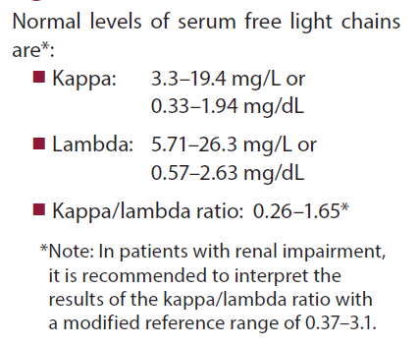
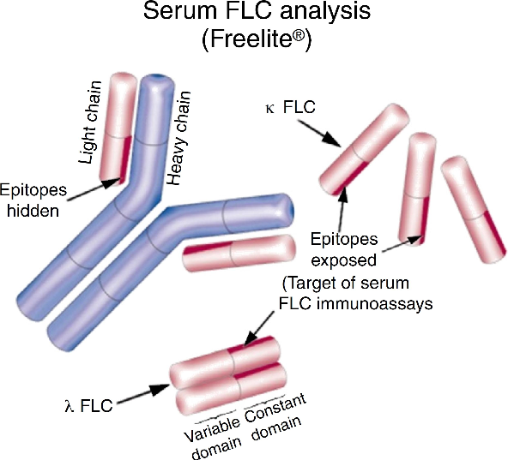

Slide 16
Serum Free Light Chains
Abnormal ratio
  Level of either kappa or lambda is very high and the other light chain is normal/low
  Indicates Myeloma
Normal ratio, but increased levels of both kappa and lambda light chains
  Indicates a disease other than myeloma, such as poor kidney function
  Both light chains retained in the blood and not removed by the kidneys
Abnormal ratio, but kappa and lambda levels at normal range:
  Indicative of a persistent low level of active myeloma

Slide 17
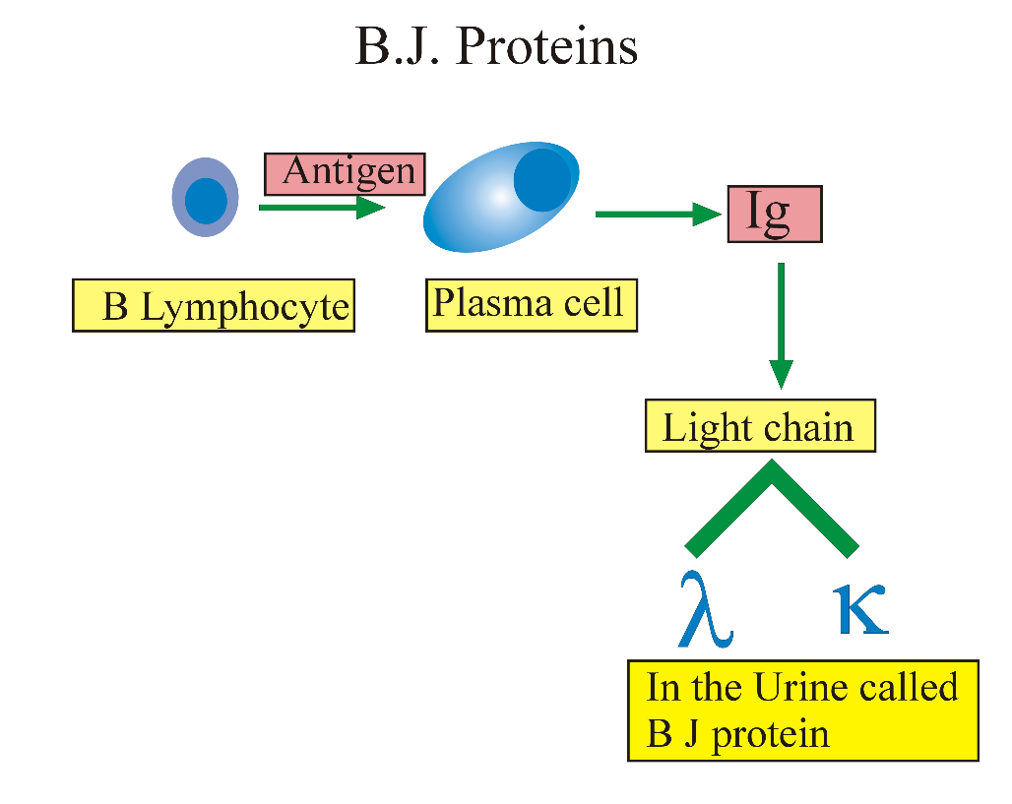
Bence-Jones Proteins-free light chains in urine
Notes:
Free light chains in the urine

Slide 18
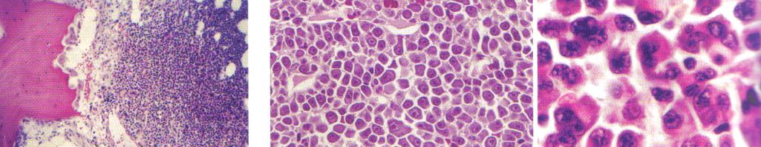
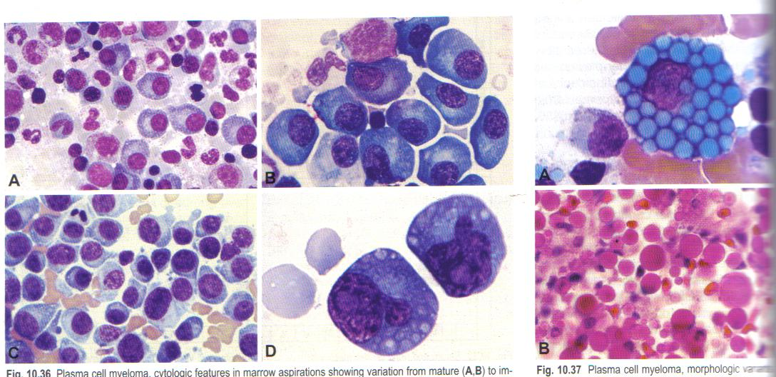
Bone marrow findings
Atypia and multinucleation
“Mott” cell with grapelike clusters of Ig protein
Plasmablasts

Slide 19
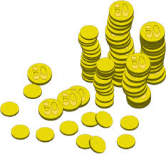
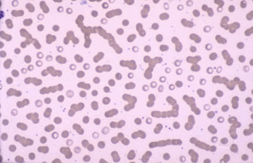
Peripheral blood findings

Slide 20
Other lab findings
CBC – Anemia, leukocytopenia
CMP – Hypercalcemia , increased levels of total protein, decreased albumin, increased BUN, creatinine, uric acid
ESR (elevated) >100
24-hour urine collection for quantification of the Bence Jones protein (light chains), protein, and creatinine clearance
Markers of cell turnover/destruction - Uric acid, LDH

Slide 21
Other lab findings
Altered albumin to globulin ration
β2 microglobulin -Surrogate marker for tumor burden
CRP – Surrogate marker for IL-6 (IL-6 is a plasma cell growth factor)
Serum viscosity (with very high M protein) CNS symptoms

Slide 22
PLASMA CELL MYELOMA, SYMPTOMATIC, CLINICAL SIGNS AND SYMPTOMS
COMMON
    Bone pain (back, long bones, pelvis) and pathological fractures
    Weakness, dizziness, fatigue (anemia)
    Dehydration, urinary frequency (renal failure)
    Headache
    Infections (depressed normal immunoglobulin production, leukocytopenia
    Fever
LESS COMMON
    Acute hypercalcemia
    Symptomatic hyperviscosity
    Neuropathy
    Amyloidosis
    Coagulopathy

Slide 23
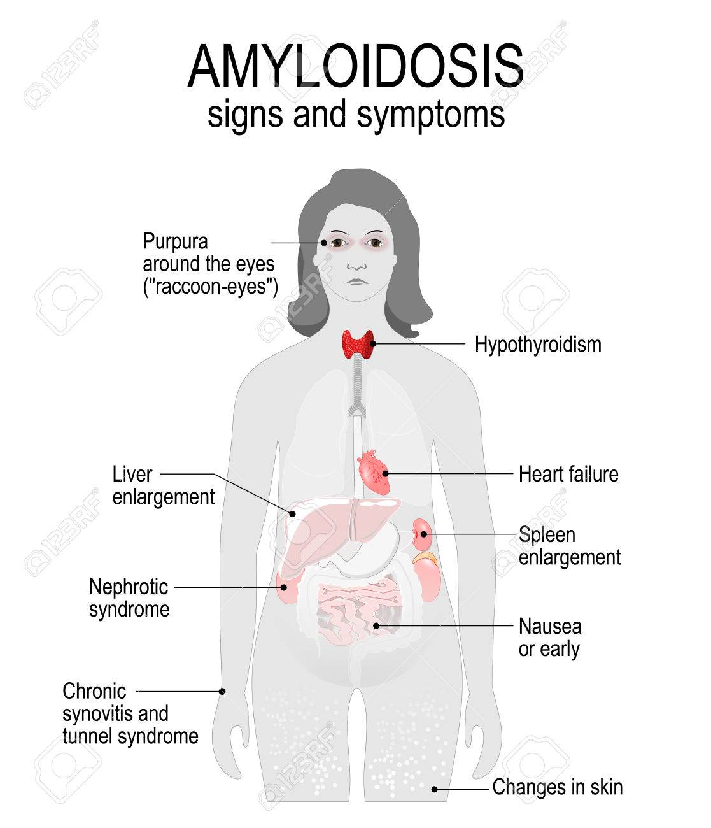
Amyloidosis
Caused by a plasma cell that secretes light chains (common) or heavy chains (rare)
Most commonly, light chains deposit in tissue as beta-pleated sheets
Called “AL” amyloid for “Amyloid Light” chains
Adults over 40, male predominance
Clinical findings relate to deposition of amyloid in organs -Kidney in MM

Slide 24
Pathophysiology

Slide 25
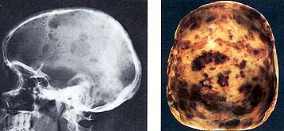
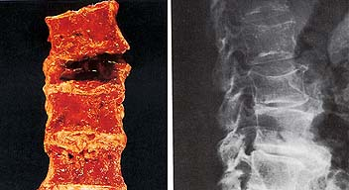
Plasma cell myeloma, Symptomatic –radiologic signs
Lytic bone lesions seen on X-ray
Notes:
Simple radiography for the evaluation of skeleton lesions; skeletal survey, including the skull, long bones, and spine
MRI for detecting thoracic and lumbar spine lesions, paraspinal involvement, and early cord compression

Slide 26
Lytic Bone lesions – autopsy

Slide 27

Disease phases

Slide 28

CRAB – defines symptomatic multiple myeloma
Notes:
For decades the diagnosis of multiple myeloma required the presence of end-organ damage known as the CRAB criteria, including increased calcium level, renal dysfunction, anemia, and destructive bone lesions.�The updated criteria allow for treatment of patients who are at such high risk of progression to symptomatic disease that it is clear they would benefit from therapy�and also potentially live longer�if they were treated before serious organ damage occurred.
M-protein in serum: IgG ≥3 g/dL, IgA >1 g/dL or
Bence-Jones protein >1 g/24h and/or
Bone marrow clonal plasma cells ≥10%

Slide 29
Calcium
Lysis of bone leads to increased calcium in the blood
30% of patients have at time at presentation
Key factors – IL6, IL1, RANKL, MIP1α and osteoblastic dysfunction

Slide 30
Renal dysfunction: Causes of renal failure in MM
Cast nephropathy
Light chain deposition disease
Primary amyloidosis
Hypercalcemia
Renal tubular dysfunction
Volume depletion
IV contrast dye, nephrotoxic meds

Slide 31
Myeloma Kidney
Two main pathologic mechanisms:
  Intracellular cast formation
  Direct tubular toxicity by light chains
Contributing factors to presence of renal failure due to multiple myeloma:
  High rate of light chain excretion (tumor load)
  Biochemical characteristics of light chain
  Concurrent volume depletion

Slide 32
Cast Nephropathy
Most common pathological diagnosis on renal biopsy in multiple myeloma
Due to light chains binding with Tamm-Horsfall mucoprotein, which is secreted by tubular cells in ascending loop of Henle, forming casts
Multinucleated giant cells surround the casts
Dehydration worsens cast nephropathy due to decreased flow in tubules, increased concentration of light chains

Slide 33
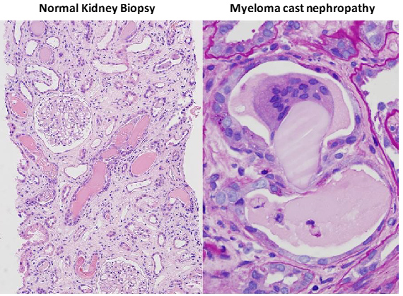
Treatment of renal failure
  IV rehydration
  Treatment of hypercalcemia
  Treatment of MM
  Plasmapharesis ?
  Dialysis if necessary
Notes:
Hypercalcemia –loop diuretics,

Slide 34
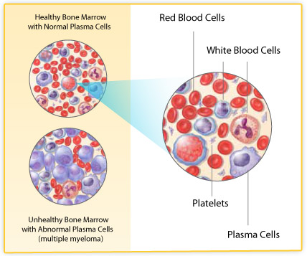
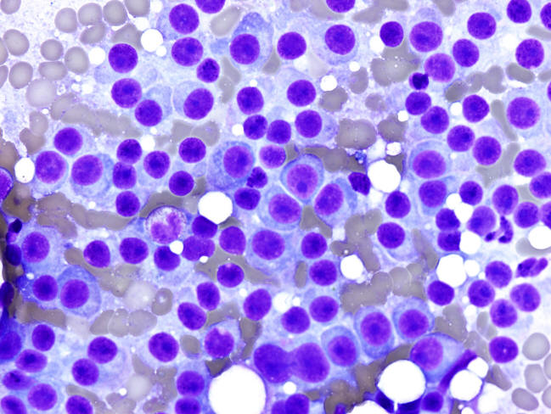
Anemia
Myeloma cells crowd out normal cells in BM
Decreased production of red cells – anemia
Can also be caused by treatments for MM

Slide 35
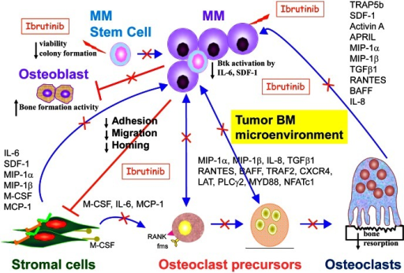
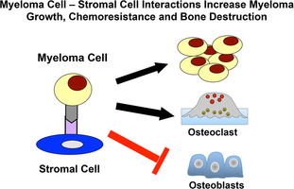
Bone lesions
Notes:
The vicious cycle of bone metastasis. Tumor cells in bone that induce osteolytic metastases (breast cancer, BCa and multiple myeloma, MM) secrete osteolytic factors (osteoclast-activating factors, OAFs) and osteoblast inhibitory factors. Growth factors, such as TGF-β, are released from the bone matrix as a result of osteoclastic bone resorption. Tumor cells that result in osteoblastic bone metastases such as prostate cancer (PCa) secrete factors that induce osteoblastic proliferation and differentiation, including VEGF, PDGF and ET1. Myeloma cells produce growth factors that stimulate the growth of bone marrow stromal cells, which in turn produce OAFs, such as IL-6, macrophage colony-stimulating factor, TNFαand RANKL, increasing the ratio of RANKL:OPG, which enhances osteoclast formation. Bone marrow stromal cells also produce soluble factors that enhance tumor growth.
Btk inhibition by Ibrutinib/PCI-32765 in MMFunctional sequelae following Btk inhibition indicates that Ibrutinib not only target tumor cells but also bone marrow microenvironment that support MM cell growth and survival, as well as MM-deteriorated bone lysis. These results demonstrate Btk inhibitors are extremely attractive approach for the novel treatment of myeloma and related bone disease. Data adapted.[3]
Mentions: Importantly, we also found that Ibrutinib is most potent against IL-6- or stromal-dependent MM cells in coculture with patient-derived bone marrow stromal cells (BMSCs) or osteoclasts (OCs), suggesting that that Ibrutinib-mediated cytotoxicity against MM cells was indirect via targeting the MM BM microenvironment. Indeed, Ibrutinib strongly reduced secretion of multiple cytokines and chemokines in MM cocultures with BMSCs, including IL-6, SDF-1, activin A, MIP-1α, BAFF, IL-8, and M-CSF (Figure 1). In particular, Ibrutinib decreased MIP1 and MIP-1β excretion in MM and WM cells, as well as OCs. Of note, in our in vitro models, Ibrutinib specifically blocked OC formation from osteoclast precursor cells and bone resorption, without affecting bone formation. These results are consistent with previous reports of Btk expression in OC, but not in osteoblasts (OB), in genetically manipulated mice.[4] In addition, Ibrutinib blocked SDF-1 secretion from BM accesory cells, as well as SDF-1-induced Btk activation and migration in MM cells. Similar results were also recently reported in CLL, which might partially explain significant clinical responses.[5]
Lytic Lesions – 60%
Osteoporosis, Fx, Compression Fx – 20%
Myeloma Cells Produce Cytokines that:
Stimulate Osteoclastic Activity
Inhibit Osteoblastic Activity
Can be Detected by Plain Xray

Slide 36
Monoclonal Gammopathy of Undetermined Significance (MGUS)
Very common (5% of people over 70)
Usually elderly patients with no symptoms
African Americans > Caucasians (twice)
Small monoclonal spike (IgG most common)
Less than 10% clonal plasma cells in marrow
No myeloma related organ/tissue impairment –NO CRAB
      CRAB: HyperCalcemia, Renal insufficiency, Anemia, Bone lesions
No evidence of other B-cell proliferative disorder
Increased risk for developing myeloma

Slide 37
Asymptomatic (Smoldering) Plasma Cell Myeloma
M-protein in serum at myeloma levels IgG ≥3 g/dL, IgA >1 g/dL) AND/OR
10% or more clonal plasma cells in marrow
NO related organ or tissue impairment –NO CRAB

Slide 38

Progression of multiple myeloma

Slide 39
Updated criteria for diagnosis of multiple myeloma – revised international staging system for multiple myeloma R-ISS
From international cancer expert groups – IMWG & NCCN, 2016
Added new biomarkers to the existing requirement for CRAB features
These biomarkers were associated with inevitable development of CRAB in patients with smoldering myeloma
The presence of 10% plasma cells in bone marrow, and any of the CRAB or any of the new 3 markers justifies the beginning of treatment
Start treatment early before have end organ effects
Updated laboratory and radiological variables

Slide 40

myeloma defining events (MDE)-”Slimcrab”
In the absence of “CRAB”, the SLIM criteria may be used
  Sixty percent (> 60%) clonal plasma Bone marrow cells
  Li – Serum free Light chain ratio involved : uninvolved > 100
  M - 1 focal lesion (> 5mm each) detected by MRI
Don’t have to wait for end organ damage (CRAB) to start treatment
“SLIM CRAB” for diagnosis

Slide 41
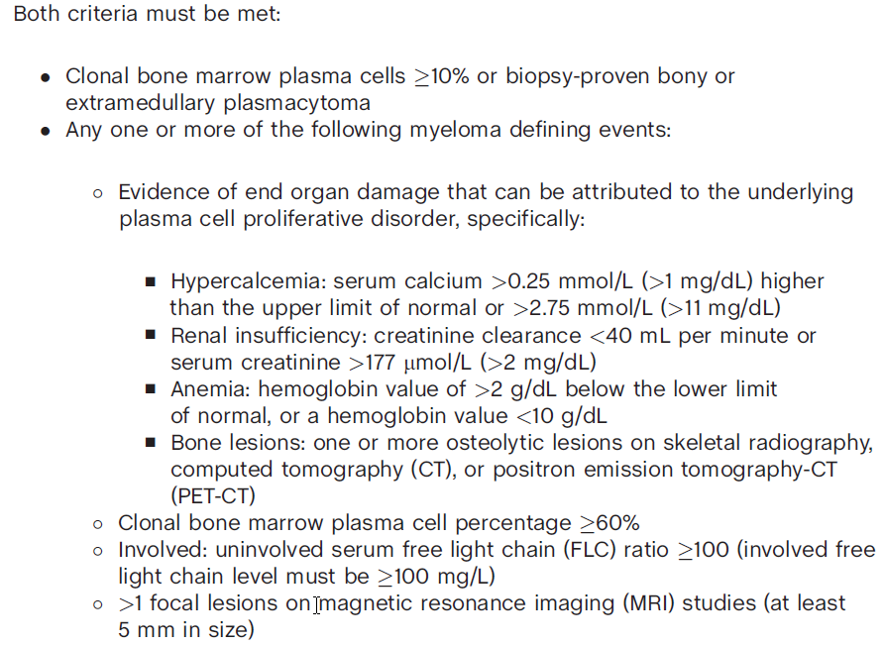
Concept of Myeloma Defining Events (MDEs)
1
2
A
B
C
D

Slide 42
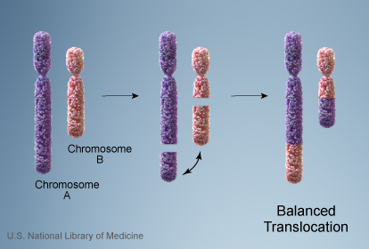
Cytogenetics terminology
Hyperdiploid -more than the usual diploid number of chromosomes
Aneuploid - presence of an abnormal number of chromosomes in a cell, for example a human cell having 45 or 47 chromosomes instead of the usual 46
Trisomy – three copies of chromosome
Deletion- deletion of all or part of a chromosome
Translocation –rearrangement of parts of chromosomes

Slide 43

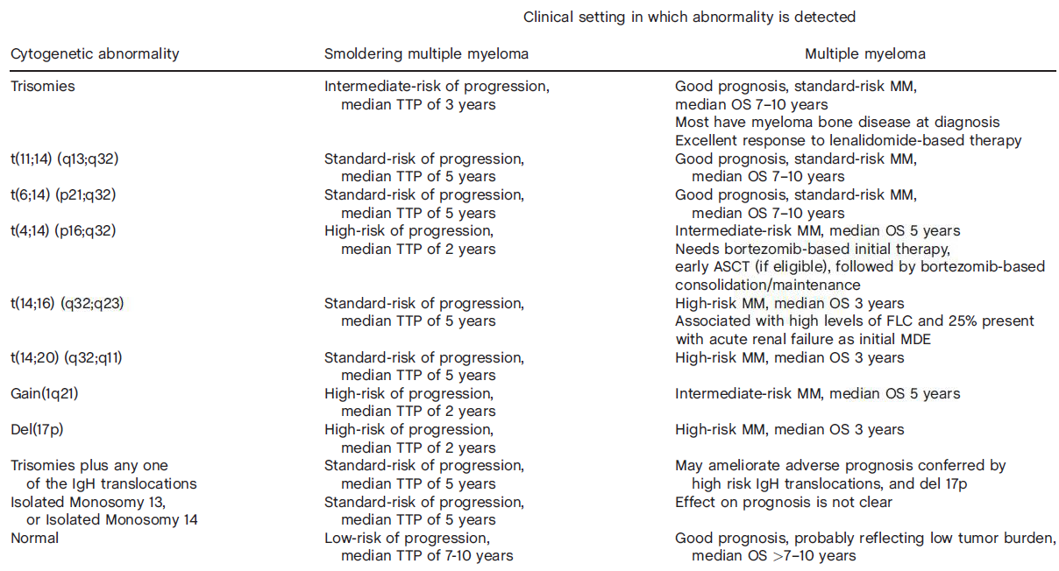
Cytogenetics findings

Slide 44
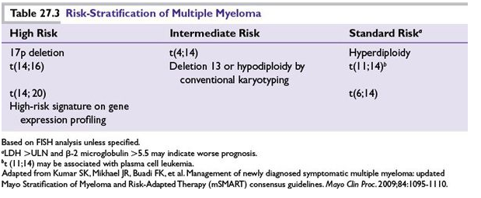

Slide 45
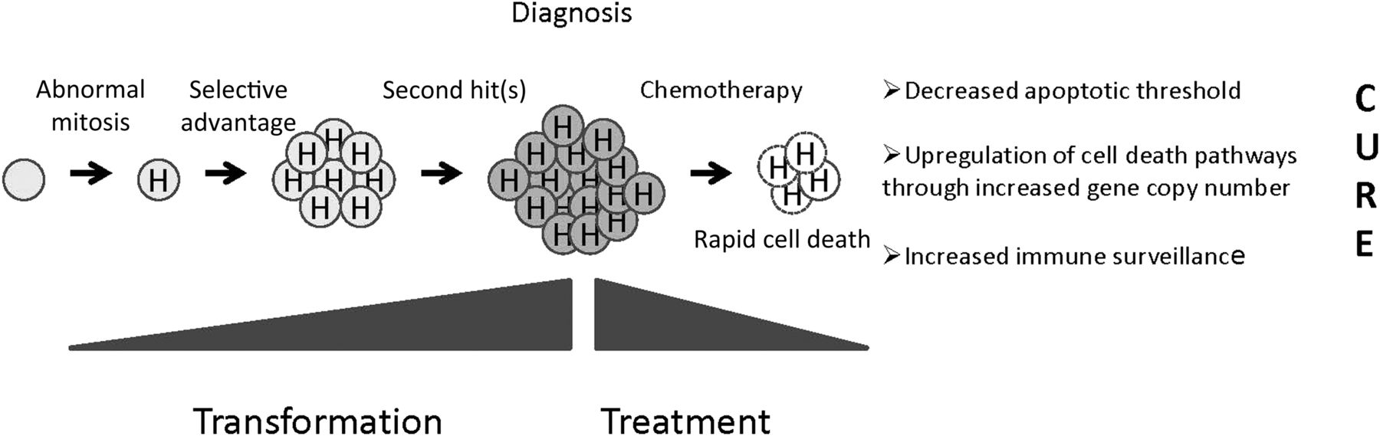
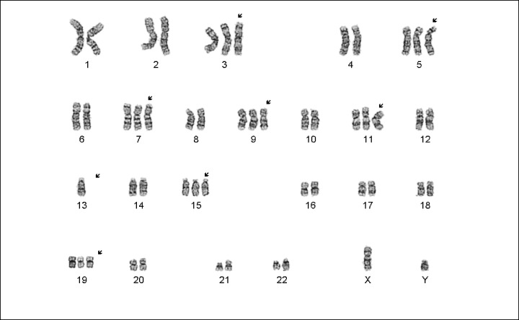
Hyperdiploidy is good

Slide 46
Plasma cell myeloma prognosis
Prognosis:
  Median survival ~ 3 years
  ~ 10% survival for 10 year
  Survival has increased

Slide 47
Therapeutic options
Currently not curable
High dose Chemotherapy with corticosteroids
Bone Marrow/stem cell transplants
Radiation
Novel agents

Slide 48
CHEMOTHERAPY
Chemotherapy - the treatment of disease by the use of chemical substances, especially the treatment of cancer by cytotoxic drugs

Slide 49
Chemotherapy TERMINOLGY
Induction therapy –the 1st treatment given; often a standard set of treatments (or called Front line therapy)
Consolidation therapy - a short course of chemotherapy, helps make the previous chemotherapy treatment and stem cell transplant work better -the goal of this therapy is to sustain a remission
Maintenance therapy - given after a stem cell transplant or after induction therapy in people who don’t have a stem cell transplant. A maintenance therapy drug is usually given in a low dose over a long period of time -the goal of this therapy is to sustain a remission
Remission – all evidence of cancer is gone
Relapse -a deterioration in someone's state of health after a temporary improvement
Minimal residual disease MRD –the small number of cancer cells that remain after treatment, responsible for relapse

Slide 50
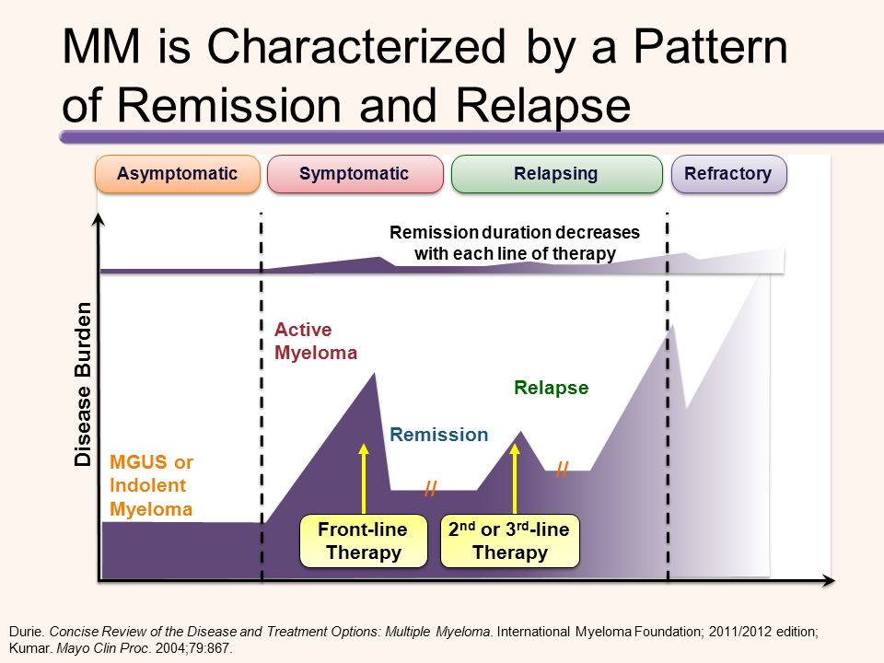

Slide 51
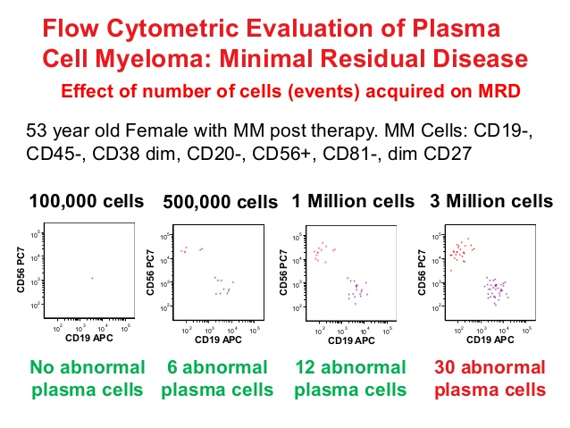
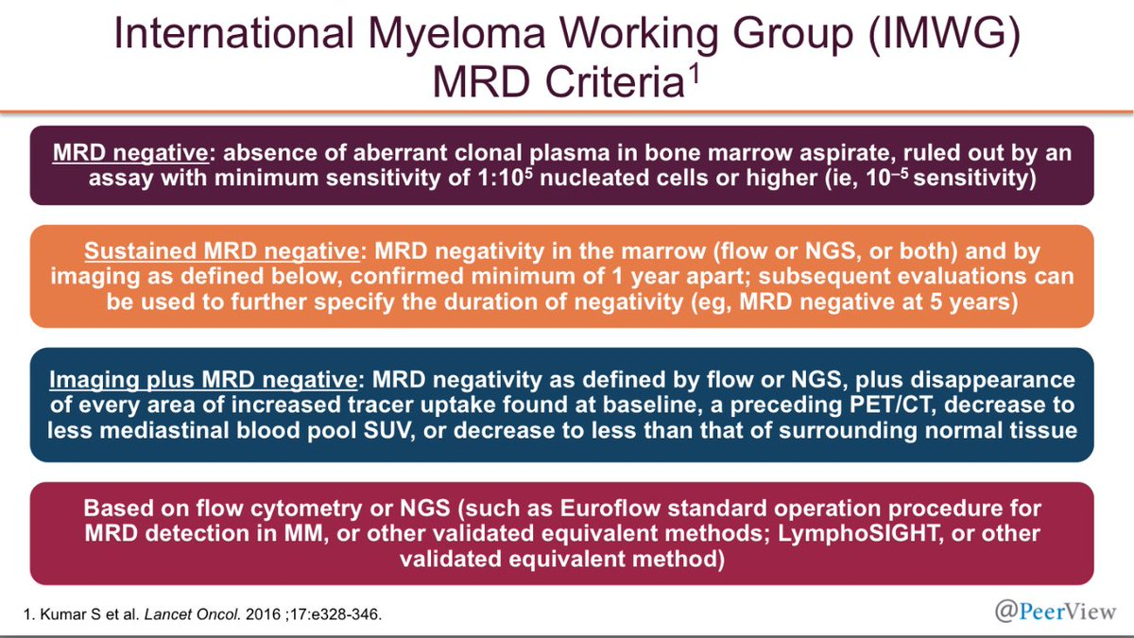
Detecting Minimal residual disease (MRD)

Slide 52
alkylating agents: melphalan (Alkeran)
Nitrogen mustard alkylating agents
An alkylating agent adds an alkyl group (C_{n}H_{2n+1}) to DNA –inhibits DNA & RNA synthesis
Side effects
  Nausea and vomiting
  Bone marrow suppression
  Pulmonary fibrosis
  Hair loss
  Myelodysplastic syndrome

Slide 53

Mitotic inhibitors -vincristine
Binds to tubulin, prevents chromosomes from separating during metaphase – leads to apoptosis
Inhibits leukocyte production and maturation
Side effects:
  Peripheral neuropathy
  Hyponatremia
  Constipation
  Hair loss

Slide 54
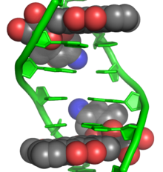
Antrhacycline antibiotics -doxorubicin (Adriamycin)
Mechanism of action -intercalates into DNA and stops DNA replication and RNA transcription
Side effects:
  Bone marrow suppression
  Hair loss
  Nausea and vomiting
  Stomatitis
  Typhilitis –acute inflammation of the bowel
  Dilated cardiomyopathy leading to congestive heart failure
  Palmar-plantar erythrodysesthesia PPE

Slide 55
Steroids (corticoSteroids)
Prednisone and Dexamethasone
Anti-inflammatory and anti-Myeloma effects
Help reduce nausea & vomiting
May be used alone or in combination
Side effects:
  High blood sugar
  Weight gain
  Insomnia
  Change in mood
  Over time, suppress immune system and weaken bones

Slide 56
vAD –standard induction therapy until recently
Vincristine
Adriamycin
Dexamethasone

Slide 57
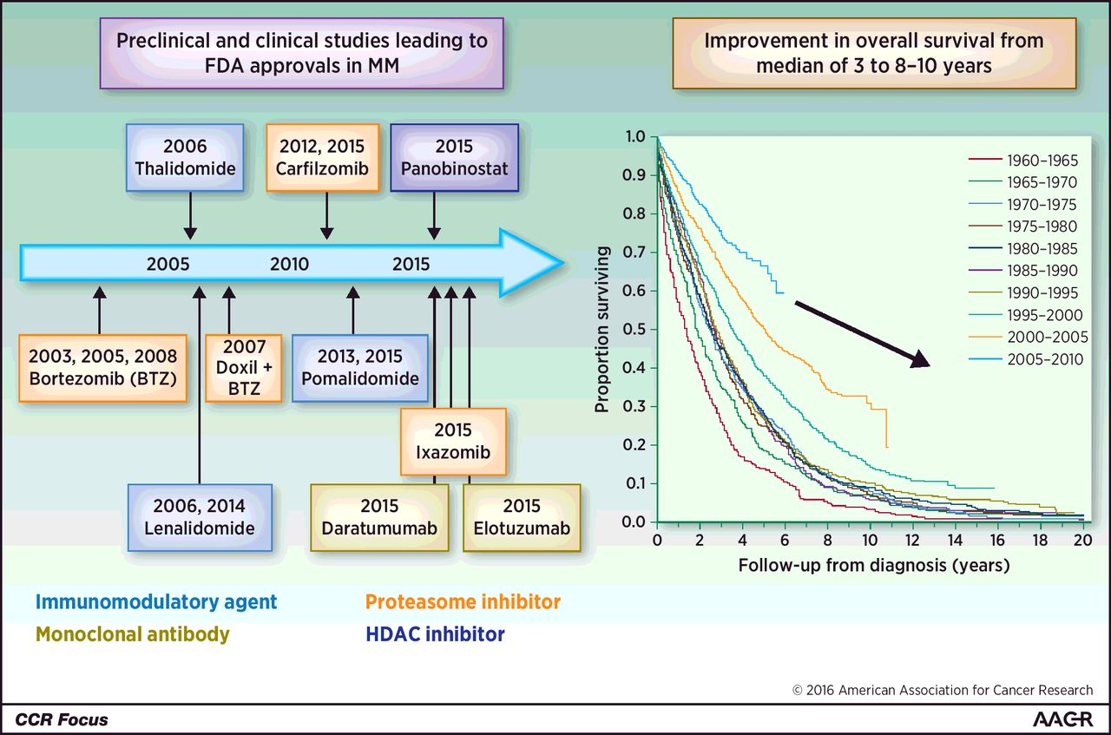
Bench to bedside translation of novel agents New drugs have improved survival in mm

Slide 58
Proteasome inhibitors - bortezomib (velcade)
Proteasomes – protein complexes that degrade proteins by breaking peptide bonds (proteolysis)
Proteasome inhibitors –drugs that block the action of proteasome - Prevent protein breakdown
Excess proteins cause cell cycle arrest and apoptosis
Boron atom binds to the catalytic site of the 26S proteosome

Slide 59
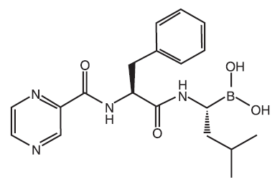
BorteZomib (velcade)
First approved proteasome inhibitor, 2003
Potentiates sensitivity to both conventional and novel therapeutic agents
IV or subQ
Mechanism of action:
  Inhibits the 26S proteasome
  Prevents proteolysis of proteins targeted (by ubquitinylation) for removal
  Disrupts homeostasis; leads to apoptosis
Side effects:
  Peripheral neuropathy
  Bone marrow suppression
  Herpres Zoster infections due to immunocompromise

Slide 60
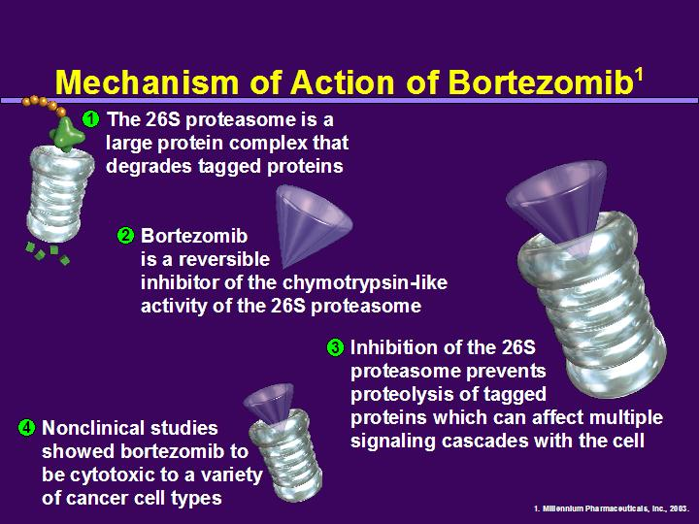
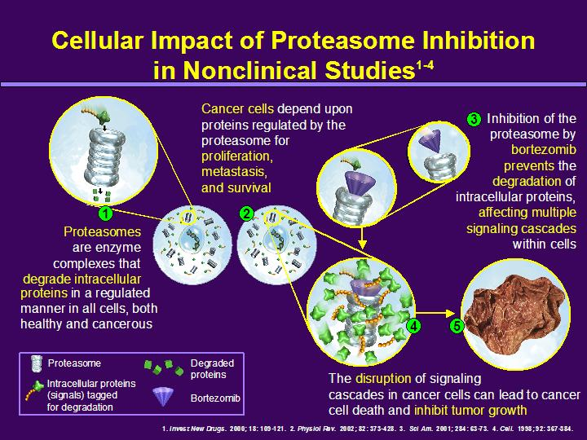
Proteasome inhibitors

Slide 61
Immunomodulatory Agents
Immunomodulatory agents (IMiDs)
Have become a key part of the treatment regimen for multiple myeloma.
Stimulate natural killer cells and activate T cells reducing the growth of myeloma cells

Slide 62
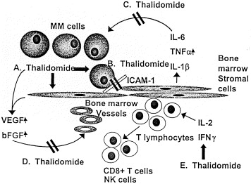
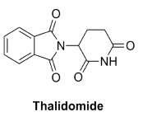
Thalidomide
First novel agent routinely used for multiple myeloma – oral
Mechanisms of action:
  Stimulation of T and NK cells
  Anti-angiogenesis (decreases VEGF)
  Suppresses MM growth factors (IL-6, TNF- a)
  Inhibits adhesion to the stroma
Side Effects:
  Teratogenic
  Peripheral Neuropathy
  DVT/PE
  Constipation
  Sedation

Slide 63
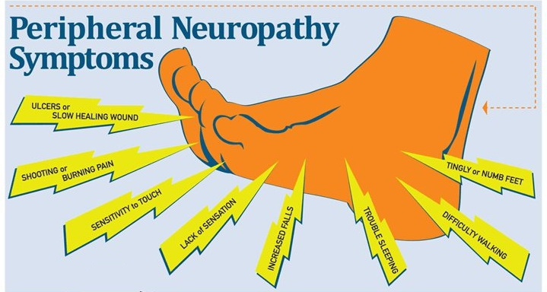
Side effect of thalidomide

Slide 64
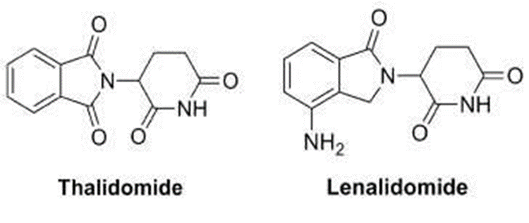
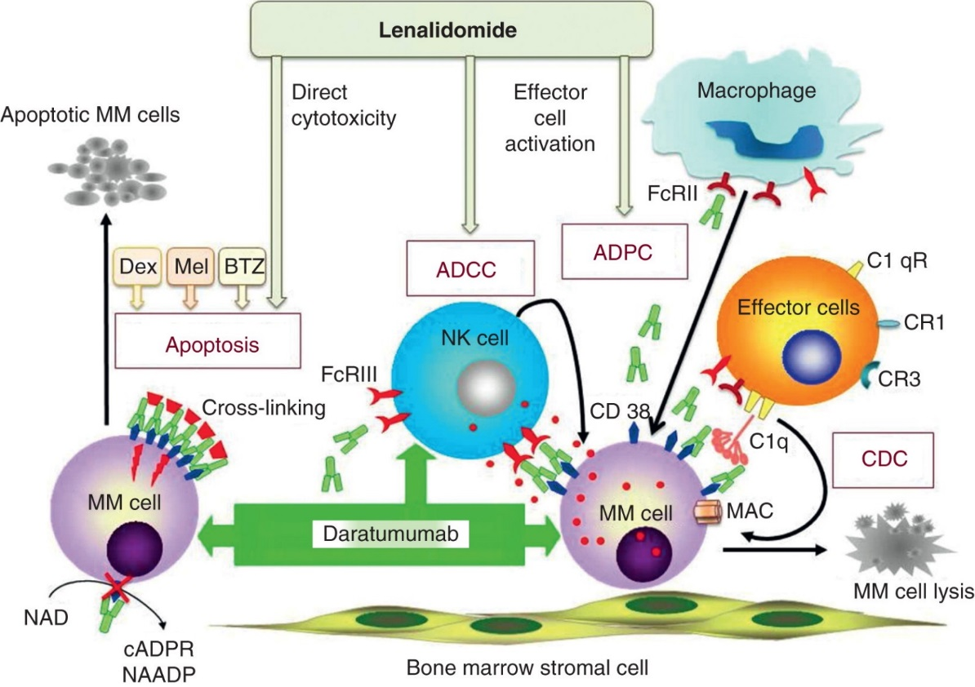
Lenalidomide (Revlimid)
Derivative of thalidomide –more potent
Oral
Fewer side effects:
  No neuropathy
  Less constipation
  Less sedation
  Less VTE
  MORE myelosuppression/cytopenias
  Maybe teratogenic

Slide 65
4 new Drugs approved in 2015
Panibostat – deacetylase inhibitor, in combination with Bortuzimab and Dex
Ixazomib –oral proteasome inhibitor, in combination with lenalinomide and Dex
Elotuzumab – Mab that targets signaling lymphocyte activation molecule F7(SLAMF7), in combination with lenalinomide and Dex
Daratumab – Mab targeting CD38, single angent

Slide 66
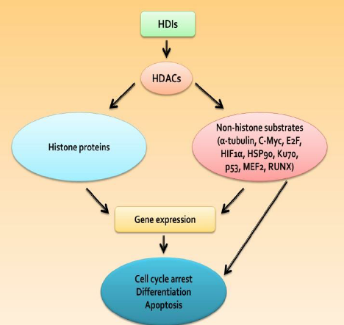
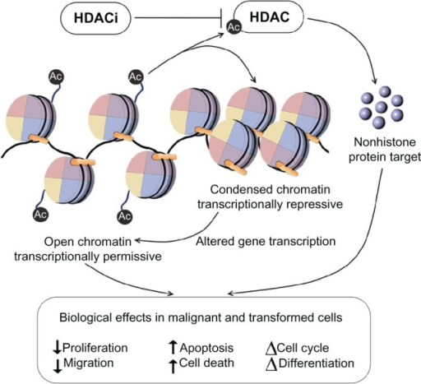
Histone deactylase inhibitors (HDACi)-
Histone deacetylation

Slide 67
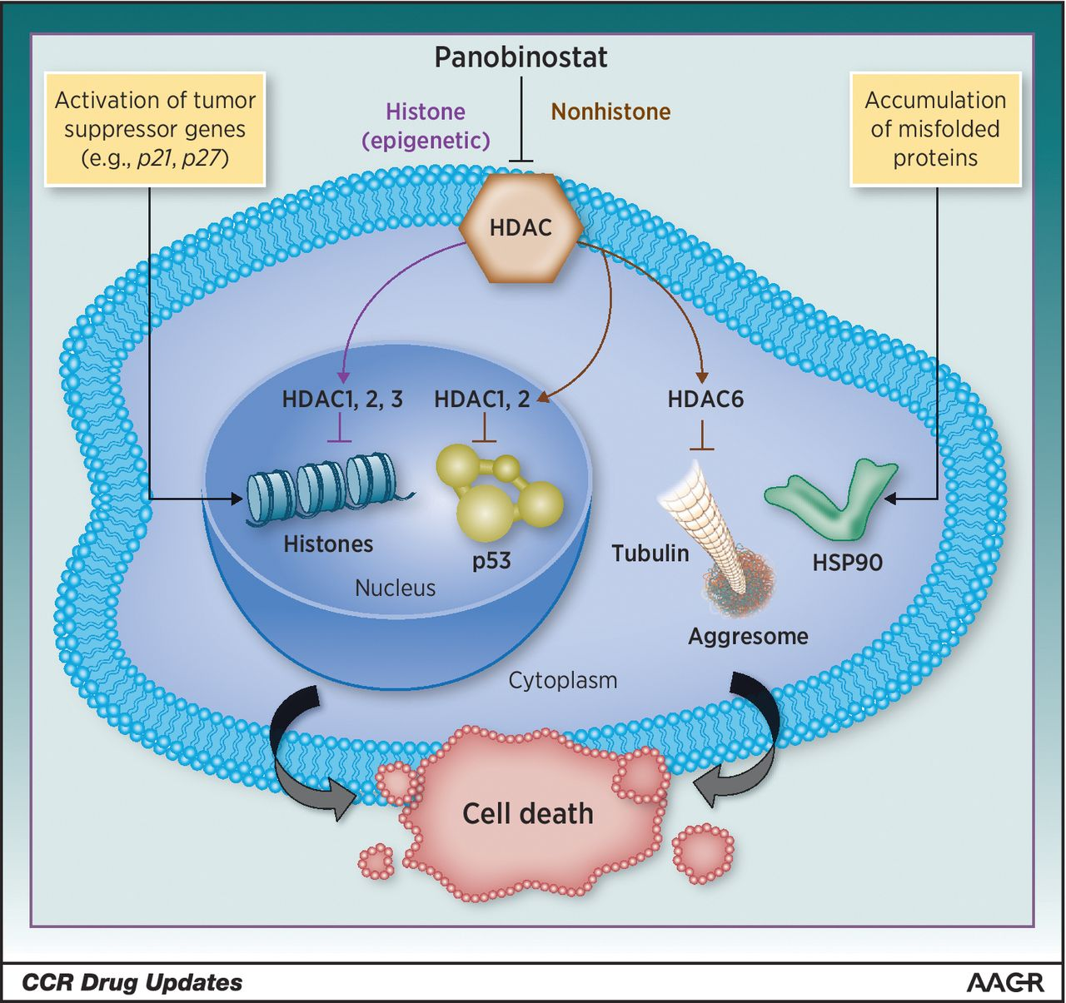
Panobistat (farydak)
Not useful as a monotherapy
Side effects:
  Pancytopenia
  Fatigue
  Nausea
  Diarrhea
  Insomnia

Slide 68
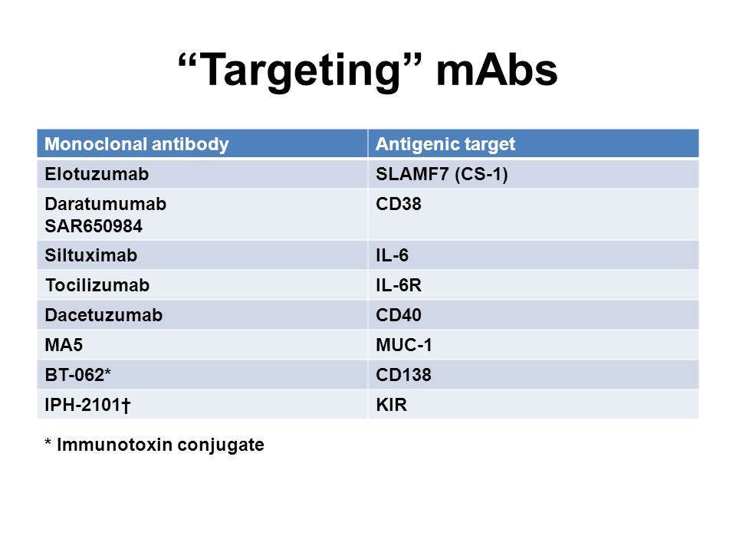
Monoclonal Antibodies

Slide 69
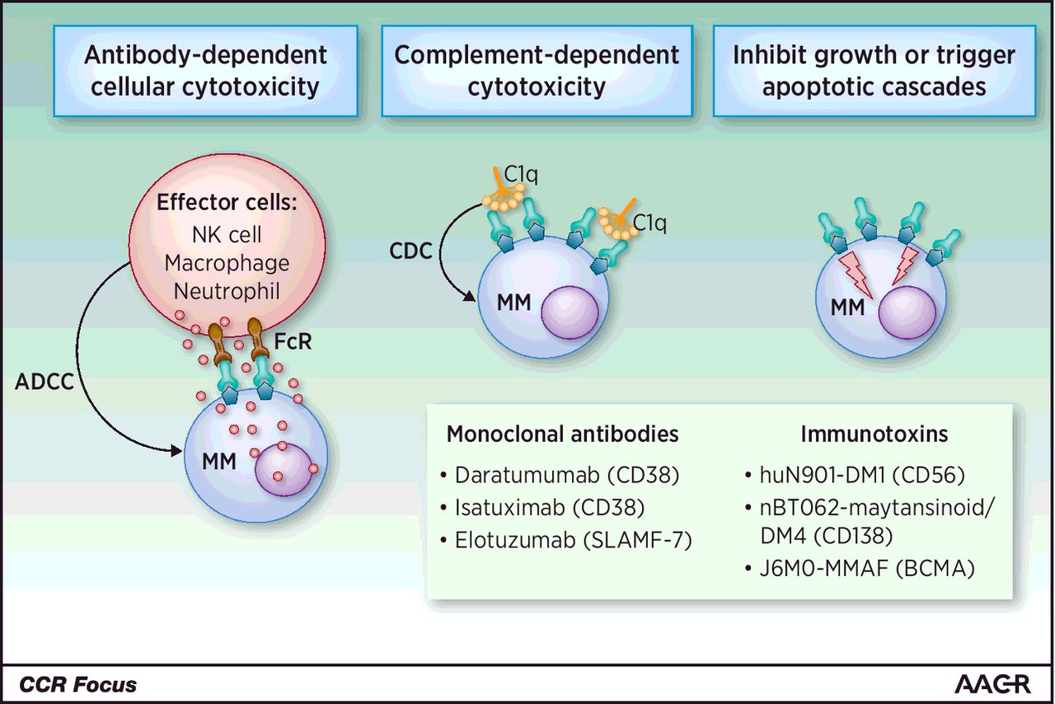
How mabs can kill mm cells

Slide 70
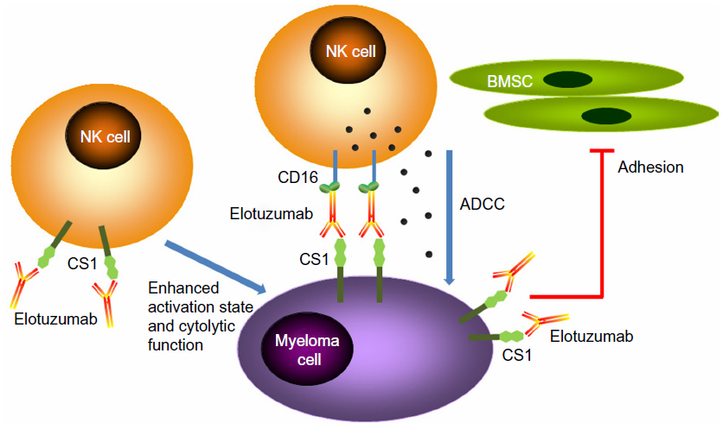
Elotuzumab (EMPLICITI) – directed against Slam7 (cs1
For patients previously treated 1 – 3 times
Used with Dex and Lenalinomide

Slide 71
daratumumab, dara (darzalex)
Human IgG antibody (mAB) that targets CD38
CD38 – a transmembrane protein abundantly expressed on malignant plasma cells; also functions in cell adhesion, signal transduction, and calcium signaling
IV infusion
Works well in combination or as a single agent

Slide 72
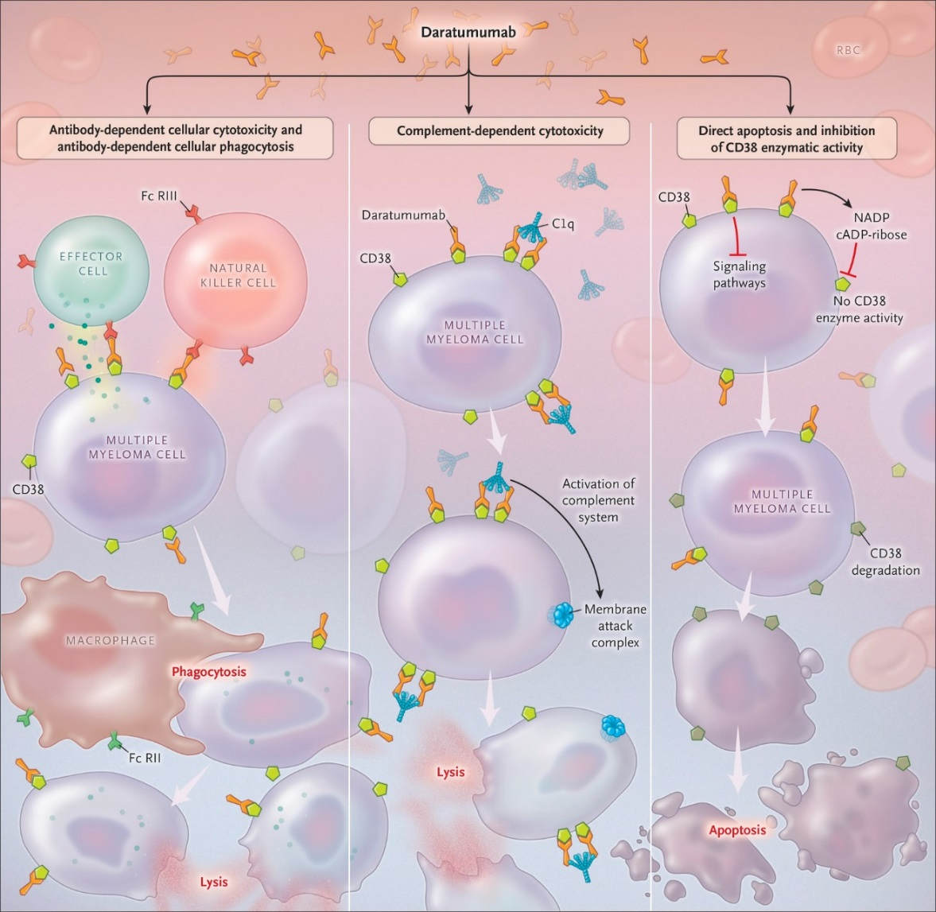
Mechanisms of daratumumab action

Slide 73

Dara combinations with OTHER THERAPIES IN relapsed-refractory mm – 2016 nejm –castor and pollux studies
Daratumab

Slide 74
1/3 of refractory mm patients responded to dara alone

Slide 75

Effects On Transfusion Testing
CD38 is weakly expressed on red blood cells
  Anti-CD-38 binds to CD38 on reagent RBCs causing panreactivity in vitro
  Positive indirect antiglobulin (IAT) tests
  Agglutination may occur in all media and all methods
    Saline, low ionic strength saline, polyethylene glycol
    Gel, tube, solid phase
  Reactions are usually weak (1+), but stronger reactions have been observed in solid phase (up to 4+)
Anti-CD38 could mask a clinically significant alloantibody

Slide 76


Slide 77


Slide 79
Managing Patients on Daratumumab
Anti-CD38 interference may cause delays in issuing RBCs
Before a patient begins anti-CD38 treatment
  Perform baseline ABORh and antibody screen
  Perform baseline genotype
After a patient has begun anti-CD38 treatment
  ABORh performed normally
  Perform antibody screen and identification using DTT treated RBCs

Slide 80
Managing Patients on Daratumumab
Crossmatch
  Antibody screen negative (using DTT-treated cells)
    IS or electronic crossmatch ABORh compatible, K matched RBCs
  Known alloantibody
    Give phenotypically similar RBCs
    May perform AHG crossmatch using DTT-treated donor cells
  Transfusion emergently required: uncrossmatched ABORh compatible RBCs can be given per local transfusion service practices

Slide 81
Managing Patients on Daratumumab
Hospitals should establish procedures to inform the transfusion service whenever any patient is scheduled to begin taking daratumumab
Set up notification in EMR when Daratumumab is ordered by physician for ABORh, Antibody Screen, DAT, and genotyping testing to be ordered
Daratumumab-mediated positive indirect globulin tests may persist for up to six months after the last daratumumab infusion
Provide wallet card to patient to notify other blood of potential interference with testing and results of genotype/phenotype

Slide 82
Other drugs in development
Selective inhibitor on nuclear export (SINE) Selinexor
Checkpoint inhibitors
Vaccines - against MAGE-A3 protein, found on the surface of
multiple myeloma cells in high-risk patients

Slide 83
Adoptive t cell therapy
In clinical trials in myeloma & other cancers
Patients have their T cells removed and activated with chimeric antigen receptors (CARs)
CARs are proteins that allow T cells to recognize a specific antigen on tumor cells (CD19, CD38, CD40, CD44, CD47, ICAM1, NCAM1, CD74, CD81, CD86, CD200, IGF1R, CD307, CD317, SLAM7, PD-L1, CD138, and B-cell membrane antigen, BCMA)
These cells are then reintroduced into the body, they will start multiplying, and with help from the engineered receptor, will locate tumor cells with the targeted antigen and destroy them

Slide 84


Adoptive t cell therapy mechanism of action

Slide 85
Transplant options

Slide 86

Tumor Markers
Patients’ genes and proteins are increasingly being measured to diagnose and manage their cancers
  Examples: BRCA1, HER2/neu, CEA, AFP
These markers can help in designing personalized treatment

Slide 87
The Ideal Tumor Marker
Testing requirements:
  Easily available source of tissue – e.g., blood sample
  Simple and reproducible test
  Accurate
Clinical requirements:
  Found in nearly all patients
  Accurately correlates with disease to:
    Predict patient outcome
    Monitor response to treatment

Slide 88

B-cell maturation antigen, BCMA
A tumor marker for myeloma (?)
  Shed from tumor cells into the blood
  Correlates with disease status
  Accurately measures the current disease status
  Can be used to quickly determine response to treatment
  In vitro studies promising
Phase I clinical trial for use in CAR therapy and antibody conjugate (2017)
Notes:
An

Slide 89

Supportive therapy
Aspirin
Calcium supplements and Bisphonates – monthly for 1 year, then q 3 months
  Dental evaluation before to avoid dental extractions & risk of osteonecrosis
Surgery to repair fractures
Kyphoplasty/Vertebroplasty for vertebral body compression fractures
Acyclovir with Bortexomid (Velcade)
Intravenous immunoglobulin prophylaxis for frequent infections
Dialysis
Collect stem cells BEFORE too much myelotoxic therapy (avoid mel and >4 cycles REV)

Slide 90
Conclusions
Between the 1960’s and the 1990’s, the prognosis MM survival was dismal
Survival improved with high dose chemo and Stem cell transplant
Survival is improving with these newer agents and SCT
Huge advances in MM treatment but patients still relapse, so newer treatments/combos are being studied

Slide 91
Questions?

