Slide 1
Improving the Mental Health and Wellness of Laboratory Personnel
October 15, 2024
Billie Whittington, MPA, MT(ASCP)

Slide 2
purpose
The purpose of this presentation is to highlight the critical importance of mental health for laboratory professionals. By identifying effective strategies for managing stress—such as taking regular breaks, practicing self-care, and seeking support from colleagues or mental health professionals—we aim to foster a culture that prioritizes well-being. Additionally, we will discuss the significance of promoting work-life balance and creating a positive work environment to enhance resilience and overall job satisfaction among lab staff.

Slide 3
OBJECTIVES
Identify and assess the stress in your laboratory.
Ways to reduce stress in your laboratory.
Identify examples of stress coping mechanisms for laboratory personnel.
Utilize mindfulness tools to improve mental health.

Slide 4
The Stress Response
Both acute and chronic stress trigger the sympathetic branch of your body’s autonomic nervous system—the “fight-or-flight” response—releasing several hormones, such as corticotropin-releasing hormone, adrenocorticotropic hormone, epinephrine, norepinephrine, and cortisol. The stress response can cause symptoms such as:
Physical: difficulty breathing, racing heart, muscle tension and pain, headaches, sickness, indigestion, or fatigue
Mental: negative thoughts, irritability, inflexible thinking, or a short-temper
Emotional: feeling anxious, fearful, angry, frustrated, sad, overwhelmed, or difficulty focusing and lack of motivation
Behavioral: sleep problems, lack of exercise, overeating, social withdrawal, or substance use
When stress becomes chronic, it can have long-lasting effects on your entire body, and is associated with cardiovascular disease, diabetes, asthma, cancer and infectious disease, obesity and metabolic syndrome, chronic pain, insomnia, anxiety, depression, and substance abuse.

Slide 5
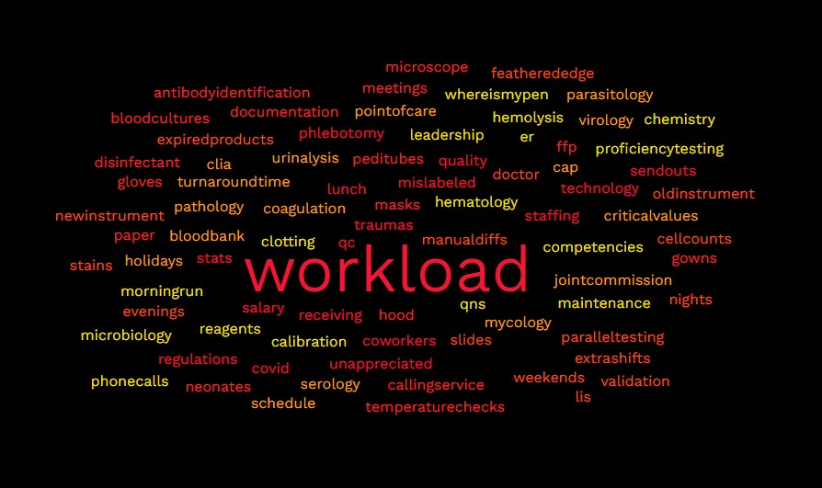

Slide 6
identify stressors in your laboratory
Staffing
Technology
Unappreciated
Coworkers / Relationships
Regulations
Quality
QC
Stats
Send Outs
Traumas
Lunch
Workload
COVID-19
Salary
Phlebotomy
Receiving
Mislabeled
QNS
Hemolysis
Clotting
Leadership
Workload
ER
Phone Calls
Competencies
Proficiency Testing
Calibration
Maintenance
Morning Run
Reagents
Where is my pen?
Hematology
Chemistry
Microbiology
Urinalysis
Blood Bank
Coagulation
Serology
Parasitology
Mycology
Pathology
Virology
Critical Values
Turn Around Time
Point of Care
Joint Commission
CAP
CLIA
Schedule Changes
Holidays
Nights
Weekends
Extra Shifts
Evenings
Cell Counts
Manual Diffs
Stains
Slides
Feathered Edge
Expired Products
Parallel Testing
Validation
New Instrument
Old Instrument
LIS
Cranky Doctor
Temperature Checks
Documentation
Paper
Meetings
Pedi Tubes
Blood Cultures
Microscope
Hood
Calling Service
Gowns
Gloves
Masks
Disinfectant
FFP
Antibody ID
Neonates

Slide 7
Assess stress in your laboratory
Medical laboratory personnel (MLPs) often experience high levels of stress in their work environment. Some common stressors include:
Heavy workload
Staffing shortages
Lack of appreciation
Workplace relationships
Rapid technological change
Organizational issues
COVID-19

Slide 8
Assess stress in your laboratory
Heavy workload: High sample counts, tight deadlines, and unrealistic expectations can lead to excessive workloads.

Slide 9
Assess stress in your laboratory
Staffing shortages: A lack of adequate staff can make it difficult to manage workloads and schedules.

Slide 10
Assess stress in your laboratory
Lack of appreciation: MLPs may feel undervalued or disrespected by other health care professionals.

Slide 11
Assess stress in your laboratory
Workplace relationships: Concerns about interpersonal relationships can be a source of stress.

Slide 12
Assess stress in your laboratory
Rapid technological change: MLPs must keep up with the latest technological advancements.

Slide 13
Assess stress in your laboratory
Organizational issues: Fiscal constraints and human health resource shortages can lead to organizational issues.

Slide 14
Assess stress in your laboratory
COVID-19 pandemic: The high demand for COVID-19 testing during the pandemic created additional stressors for MLPs.

Slide 15
How to Cope with Stress
Step One: Be Aware of Your Stress
The first step in stress reduction is being aware that you’re experiencing stress. The pace and intensity of the biomedical research field may make it difficult to slow down and notice how you’re doing. Take a moment to check in with yourself and ask:
What symptoms of stress do I experience?
How does stress impact me physically, emotionally, mentally, and behaviorally?
Are there ways to improve my stress management?

Slide 16
How to Cope with Stress
Step Two: Find Techniques to Cope with Stress
Relaxation techniques: try deep breathing, visualizations, or progressive muscle relaxation.
Meditation and mindfulness: practice mindfulness, meditation, yoga, or tai chi.
Exercise: make it fun and something you’ll look forward to doing alone or with a friend. Try the gym, walking, dance class, or hiking.
Time management and prioritization: develop an organizational system to help track your projects and tasks. Use a planner and calendar, pause Slack and phone notifications, don’t overbook yourself, prioritize tasks depending on their importance and urgency.
Realistic goals: make a list of goals for the day and week, break down your to-do list into manageable stretches, take 5–10 minute breaks in between tasks to reset, and focus on one task at a time.
Quality sleep: get 6 or more hours of sleep each night, minimize screen use an hour before bedtime, keep to a regular sleep schedule, and reduce caffeine and alcohol intake.
Healthy eating: don’t skip breakfast, eat three meals a day plus healthy snacks, and try batch cooking: cook a few items over the weekend that can last you throughout the week for easy and cost-effective meal planning.
Social support: reach out to friends, family, and trusted peers for support and social engagement. Remember you are not alone in your experience of stress and it’s important to talk about it.
Hobbies and leisure time: keep investing in your interests as a means for fulfillment and as a stress reliever—reading, photography, hiking, sports, spending time with friends and family, or whatever you enjoy!

Slide 17
How to Cope with Stress
Step Three: Get Help When You Need It
The third step is recognizing when clinical intervention like psychotherapy or medication management might be helpful. When stress goes unmanaged, it can lead to more significant mental health concerns such as anxiety and depression.
Cognitive behavioral therapy, self-compassion, and mindfulness are approaches that I find very effective in helping clients foster positive mindset shifts and tame the negative thinking, anxiety, and depression that can arise from stress.
Most employers offer Employee Assistance Program (EAP) as a benefit. This service is free and confidential.
If you are a student, contact your college’s or university’s student health center to learn about your mental health benefits.

Slide 18
Identify examples of stress coping mechanisms for laboratory personnel
To help manage stress, MLPs can:
Prioritize self-care: Take scheduled breaks and engage in activities that help them decompress.
Learn to say "no": Set boundaries and learn to say "no" when you don't have time to take on additional tasks.
Use automation: Adopt products that can help automate repetitive tasks and save time.

Slide 19
Key Areas of Self-Care
Physical – activities, sleep, medical care
  Exercise 150 minutes a week – American Heart Association recommendation
  Fun activities
  Sleep
  Nutrition
Psychological – think, grow, learn, mental health
  Meditation
  Deep breathing

Slide 20
Key Areas of Self-Care
Emotional – aware of feelings and thoughts, explore thoughts, reflection
  Journaling
  Sharing feelings with friends
  Play music
  Reading
Social – build strong relationships, having a support system, being part of a team
  Group outings
Professional – work/life balance, take time off
  Stop overextending
  Establish work/life boundaries
  Prioritize the things that make you happy

Slide 21
Key Areas of Self-Care
Environmental – organized, relaxing, clutter free, comfortable, conductive for productivity
  Decluttering living spaces has been associated with helping improve mental well-being
Spiritual – doesn’t have to be religion
  Volunteer
Financial – planning, conquer bad money habits

Slide 22
Time Management
Lack of time management leads to stress and frustration. Medical lab professionals can:
Make a schedule
Plan self-care breaks
Delegate
Take a lunch
Bathroom breaks
Make a to-do list
Ask for help

Slide 23
Delegation
Right task
Right circumstance
Right person
Right supervision
Right communication

Slide 24
When the body feels too much stress for a long time – it will begin to shut down
Cardiovascular system –cardiac disorders, hypertension, myocardial infarction, heart failure, stroke
Immune system – Cortisol decreases chances of fighting off germs
Genitourinary system – bladder dysfunction, incontinence, UTI, pelvic pain, overactive bladder

Slide 25
When the body feels too much stress for a long time – it will begin to shut down
Neurological system – stress hormones released – heart rate, blood pressure – heart attack, stroke
Gastrointestinal system – muscle spasms, IBS, constipation, diarrhea, gastroesophageal reflux

Slide 26
Workplace hazards
Work related injury – physically demanding
Infectious disease – exposure to infectious diseases can cause stress
Burnout – because of fast paced complex work environments, physical demands, staffing problems – leads to poor patient outcomes, poor work performance, fatigue

Slide 27
Negative Coping Mechanisms
Skipping meals
Working too many hours
Working when injured
Substance abuse

Slide 28
Barriers to Self-Care
Extrinsic Barriers - Interpersonal influences
  Lack of resources
  Time
  Lack of coworker / employer support
  Shift work
  Demands outside of the work place – child/dependent care, natural disasters, pandemics, trauma
  Lack of knowledge related to a need for self-care

Slide 29
Barriers to Self-Care
Intrinsic Barriers – internal factors
  Age
  Gender
  Fatigue
  Anxiety
  Depression

Slide 30
Burnout Symptoms
Frustration
Feeling unappreciated
Sadness
Apathy
Poor self-care
Lack of motivation
Exhaustion
Poor hygiene
Overwhelmed feeling
Lack of focus

Slide 31
Methods to Fight Burnout
Breathing
Identify stressors
Boundaries
Learn to say no
Delegate
Schedule quiet time
Healthy activities – sleep, exercise, fresh air, healthy foods
Practice gratitude
Find Support

Slide 32
Practicing Self-Care – Promoting Healthy Behaviors
Physical – exercise, sleep, hydration, diet
Mental/Emotional – gratitude, self-reflection, stress management, express emotions, emotional outlets
Social – events, family time, social gatherings, relationships, clubs, organizations, support, hobbies
Spiritual – An individual’s essence as a person – mindfulness, meditation, volunteer work, faith

Slide 33
Personal Plan – How To Guide
Create a routine – breaks, lunch
Set boundaries – say no if it’s too much
Reward yourself
Participate in activities
Develop hobbies

Slide 34
Benefits of Self-Care
Stress is under better control
Minimize errors or adverse events – patient safety
Higher quality of care for patients
Decreased depression
More energy
Better sleep quality
Decreased risk off health problems
Increased learning and brain function
Improved immune system

Slide 35
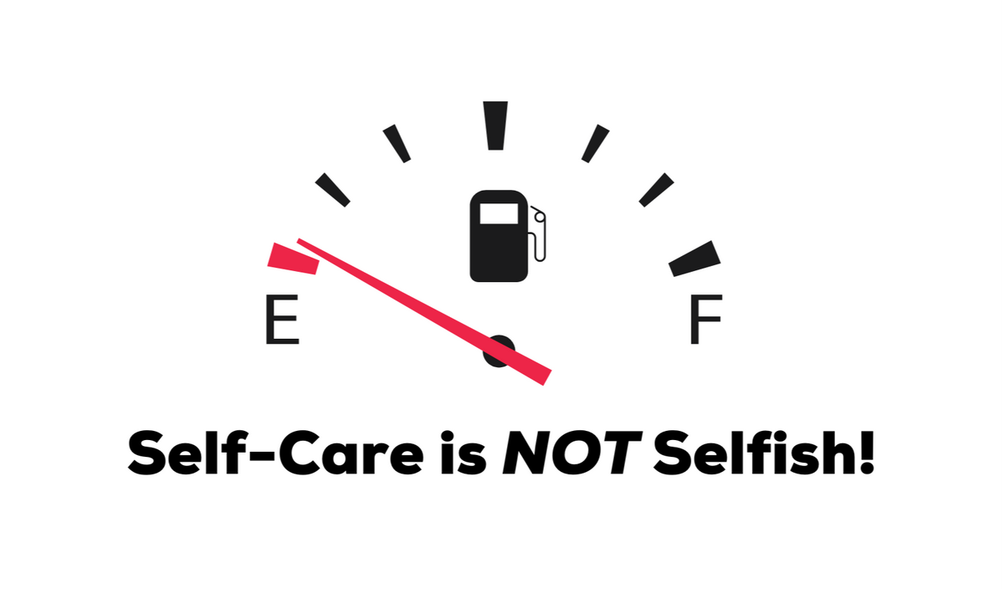
Self-care is not selfish
The best way to care for others is to care for yourself first!

Slide 36
CONCLUSION
Discussed the background of medical lab professionals and its importance to self-care.
Defined self-care and key concept areas of self-care.
Examined the benefits when lab professionals actively engage in self-care.
Discussed the effects of stress on the body and barriers commonly seen when not practicing self-care.
Reviewed strategies to increase self-care.

Slide 37
resources
Djukic B, Nielsen C. Mental health status of medical laboratory professionals. Healthc Manage Forum. 2022 Jul;35(4):207-212. doi: 10.1177/08404704221088471. Epub 2022 May 9. PMID: 35534299.
Dignos PN, Khan A, Gardiner-Davis M, Papadopoulos A, Nowrouzi-Kia B, Sivanthan M, Gohar B. Hidden and Understaffed: Exploring Canadian Medical Laboratory Technologists' Pandemic Stressors and Lessons Learned. Healthcare (Basel). 2023 Oct 14;11(20):2736. doi: 10.3390/healthcare11202736. PMID: 37893810; PMCID: PMC10606905.

Slide 38

QUESTIONS

